Slide 1

Analysis of the bread wheat genome using whole-genome shotgun sequencing
Manuel Spannagl
MIPS, Helmholtz Center Munich
Notes:
Thanks for inviting
Challenge the sheer size and complexity
Use comparative genomics and integrative genomics
Reduction of complexity

Slide 2

Wheat - why bother?
Many varieties incl. bread wheat, durum („pasta“) wheat…
Third most-produced cereal with 651 millions tons (2010), cultivated worldwide in different climates
Leading source of vegetable protein in human food
Notes:
Economic accesability of large (but average sized) genomes; However analytical barriers....

Slide 3
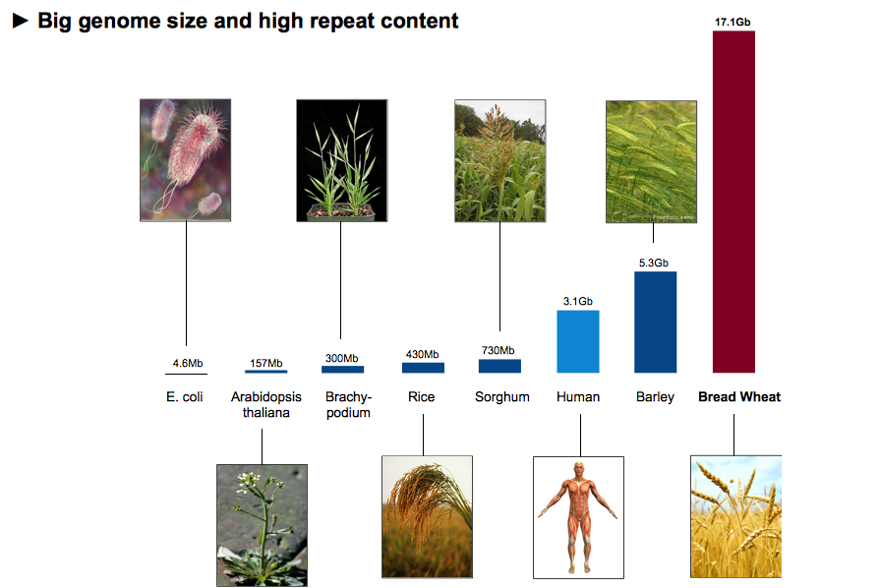
The Challenge
Notes:
Economic accesability of large (but average sized) genomes; However analytical barriers....

Slide 4
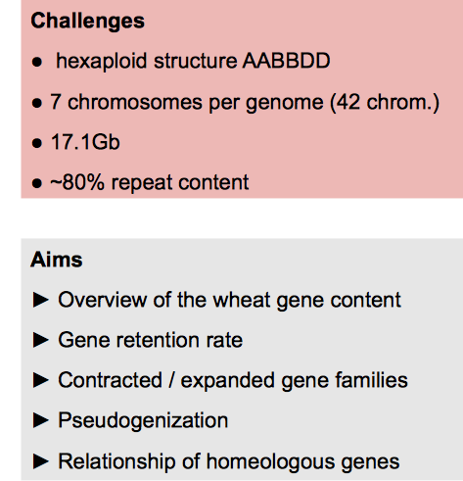
Wheat – a WGS approach Aims and Goals

Slide 5
Wheat – a WGS approach
5x 454 WGS sequencing => 85 Gb sequence, 220 million reads
~79% of reads repeat-related
direct Low-copy-number genome assembly (LCG, Newbler) => collapses many homologous gene sequences
to prevent collapsing of homologous gene sequences and reduce complexity => orthologous group assembly at high stringency

Slide 6
WGS assembly using „in silico exon capture“
Use fully sequenced and analysed reference genomes (rice, Brachypodium, sorghum)
Group genes into families (Orthologous Groups)
Use the orthologous group representatives as sequence baits to capture corresponding sequence reads.
Do sub-assembly for each „orthologous bin“ seperately

Slide 7
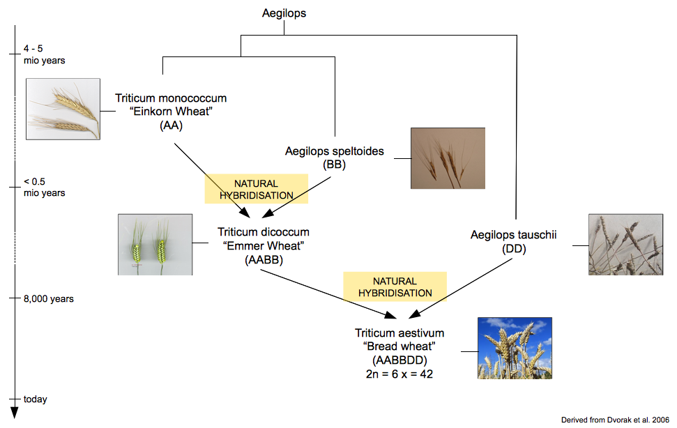
Bread Wheat Genaology

Slide 8
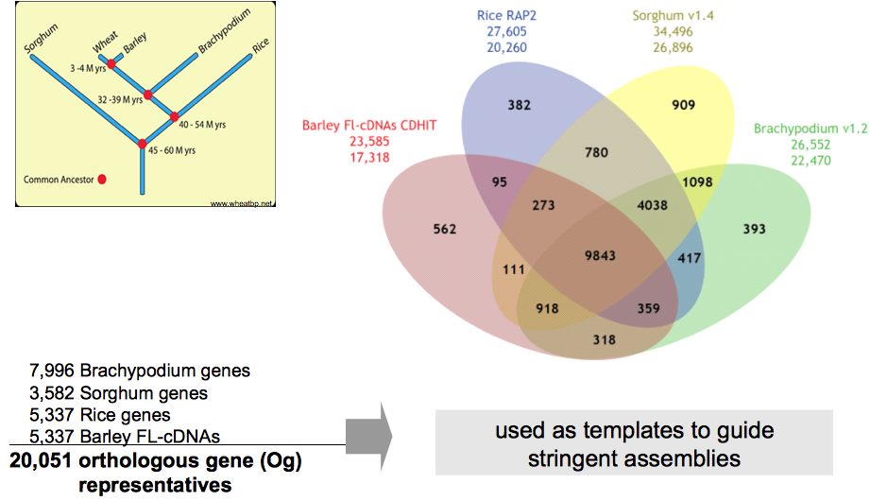
Ortholome directed assembly circumvents limitations faced by WGS assembly
Notes:
Profit from related genomes and their genome resources and flcDNA resources
generate Ortholome
In silico exome capture
High stringency assembly of each orthologous group

Slide 9
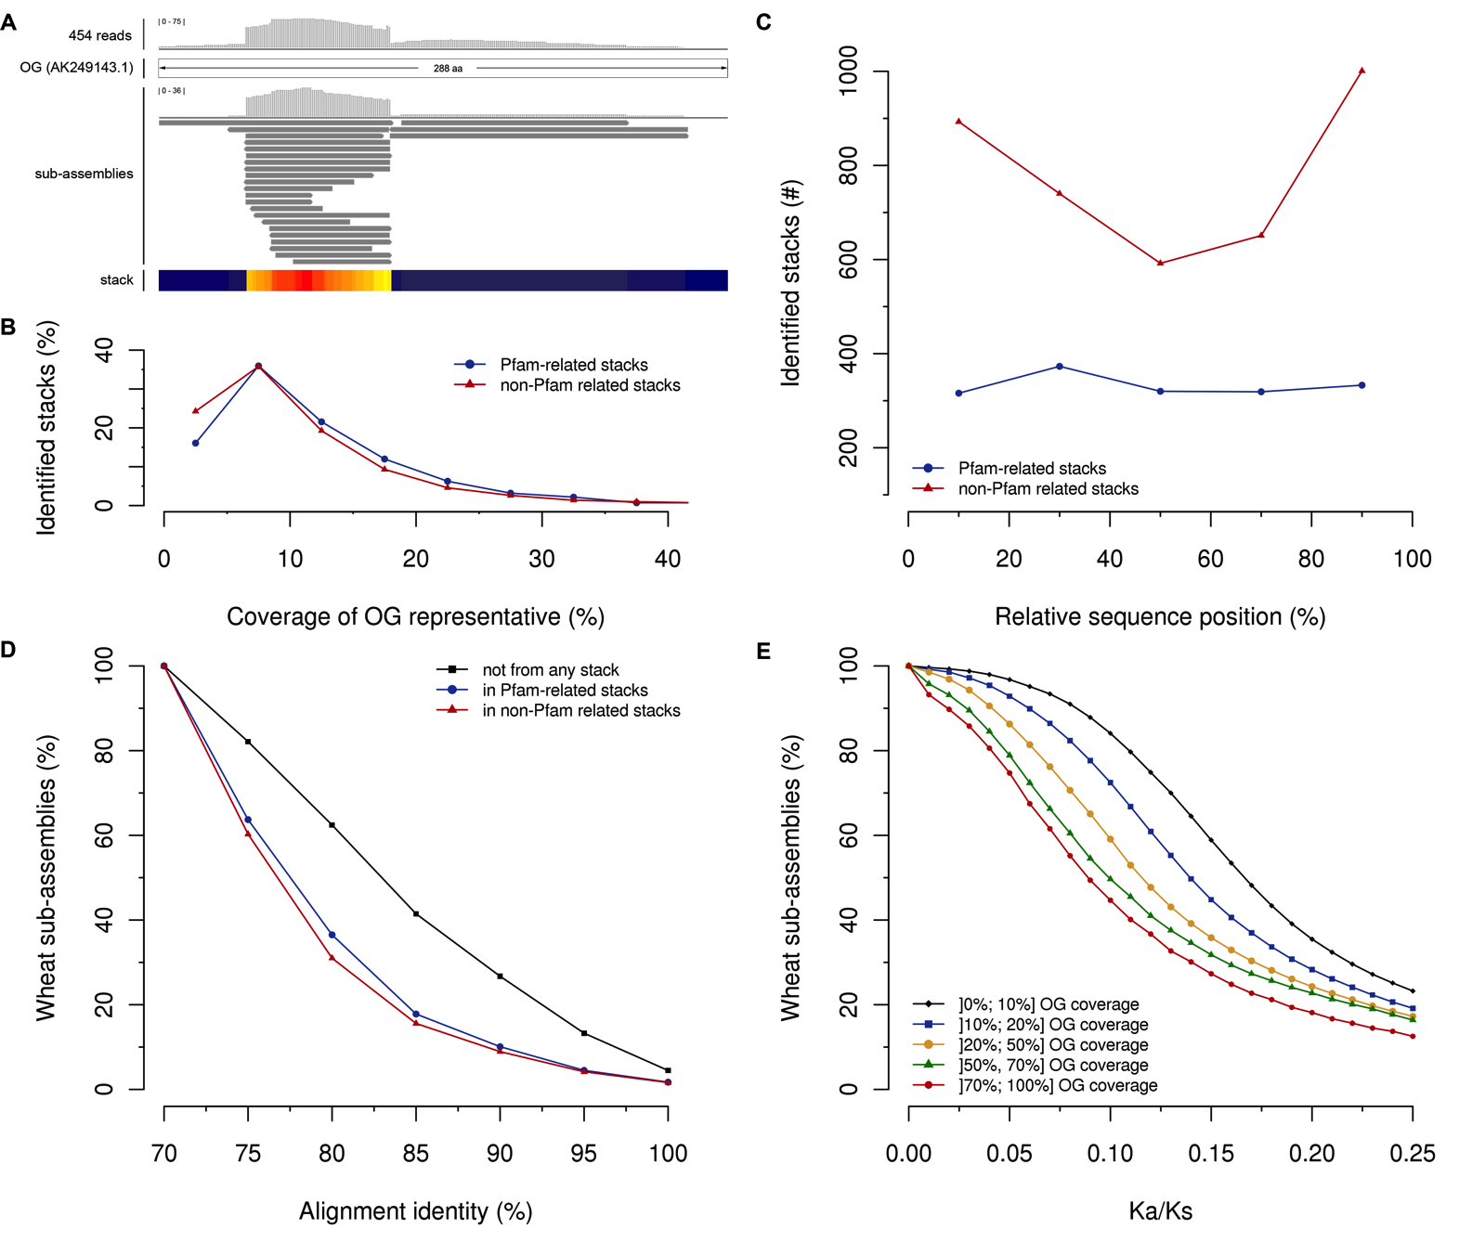
The ortholome directed assembly delivers ordered segments

Slide 10
The ortholome directed assembly delivers ordered segments II
1
2
3

Slide 11
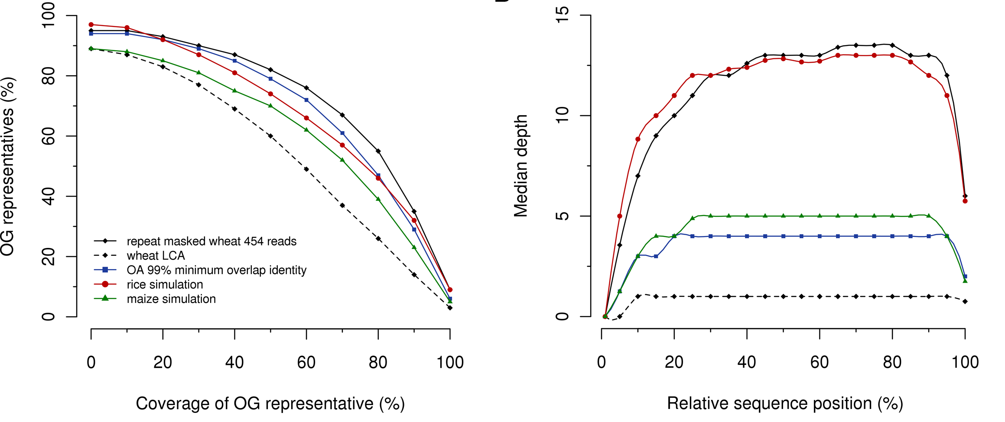
Coverage of Orthologous Group

Slide 12
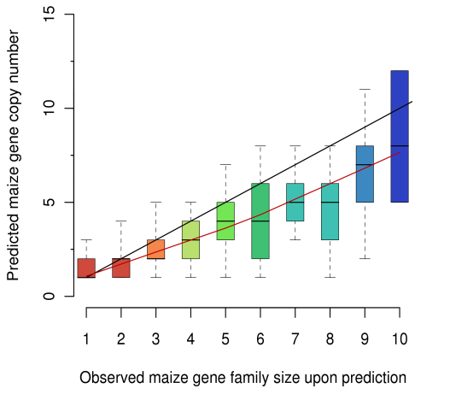
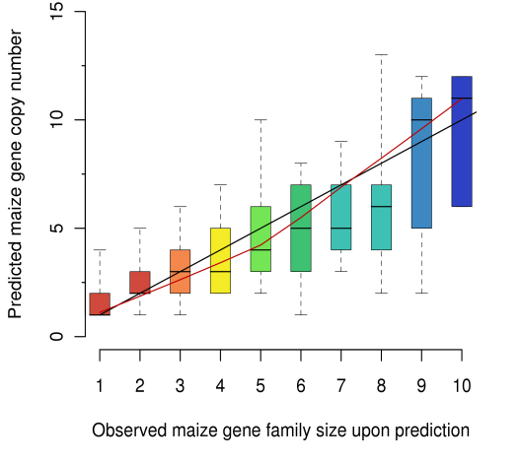
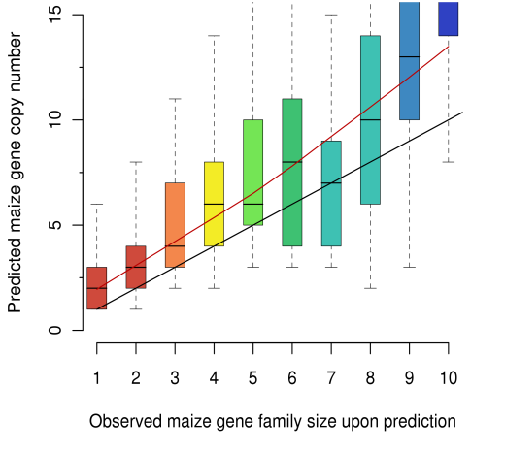
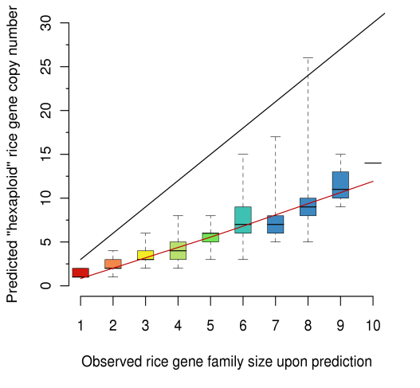
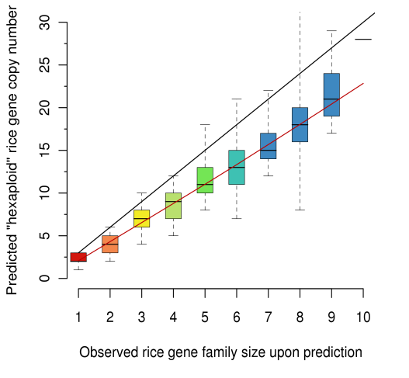
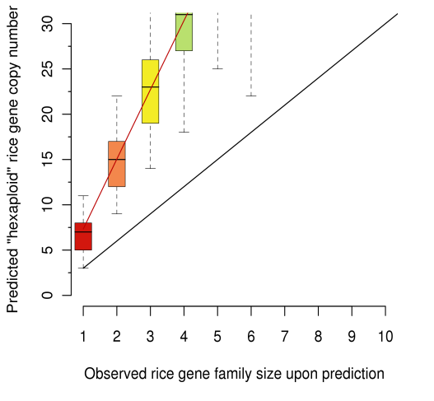
Gene Copy Retention after Polyploidization
- Calibration of the method-
Maize
97%
99%
100%
Hexaploid Rice
„TRice“

Slide 13
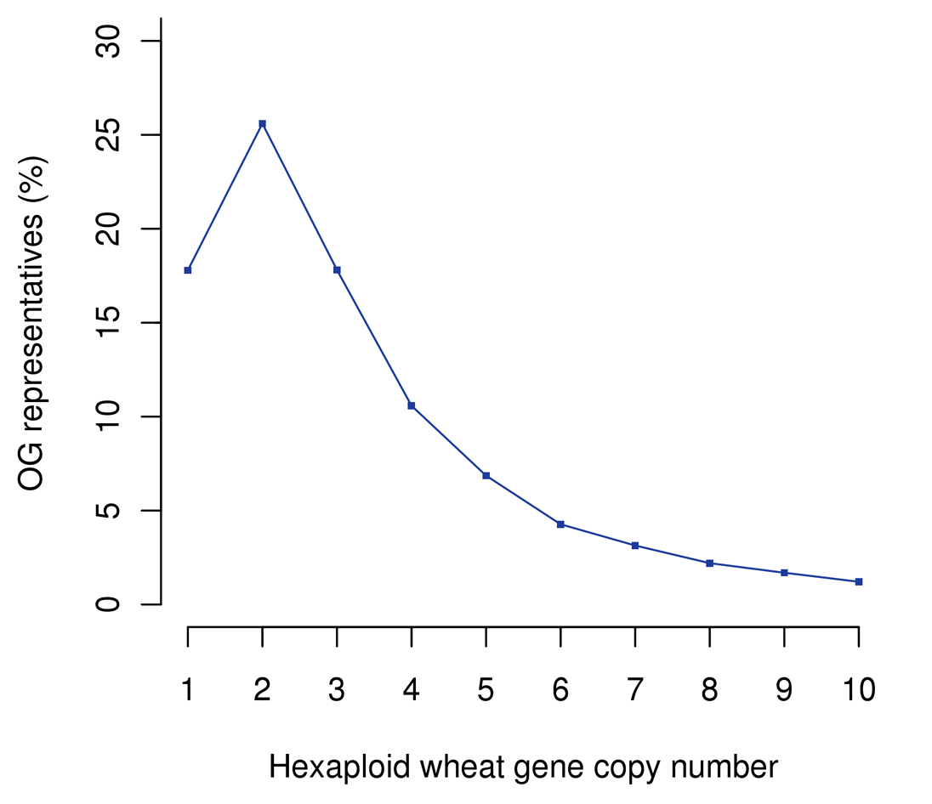
Gene Copy Retention after Polyploidization
Notes:
Involves lots of testing and evaluation on assembly parameters to use:
97, 99, 100% overlap accuracy
depending on criteria gene copy number detection variabilities as consequence of similarity among genomes;
in the end 2,1 copies per gene retained

Slide 14
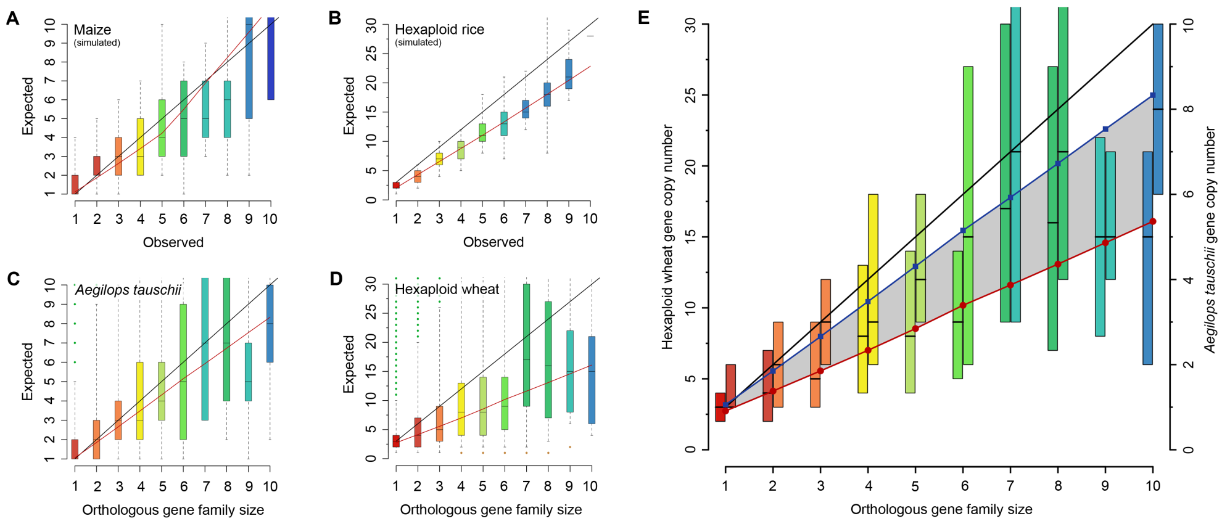
Gene Copy Retention after Polyploidization

Slide 15
Gene fragments are abundant in wheat

Slide 16
Gene fragments are abundant in the wheat genome

Slide 17
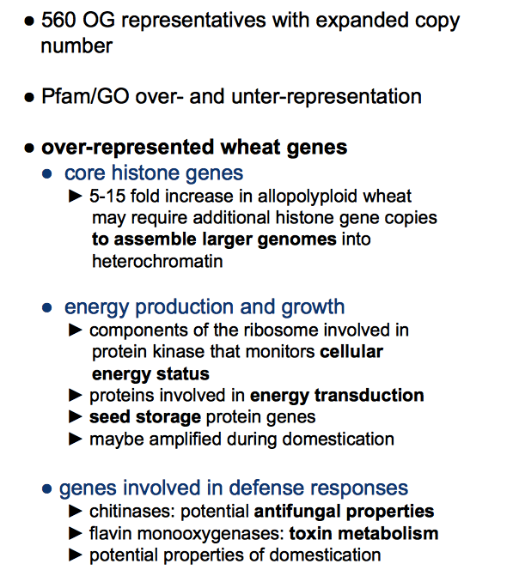
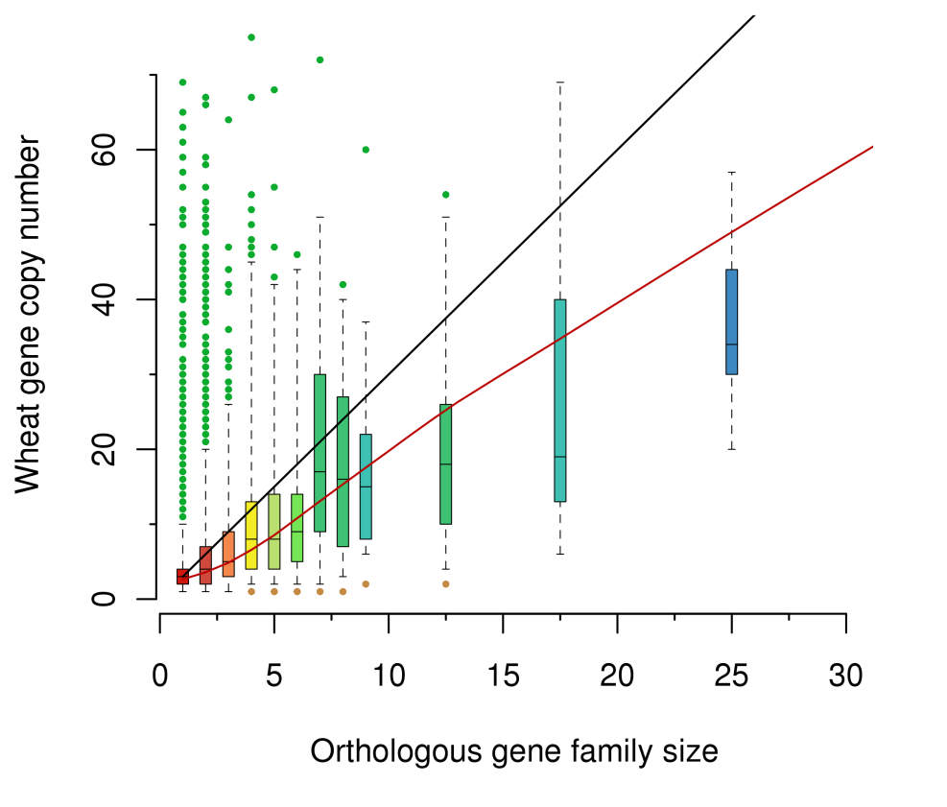
Expanded Wheat Gene Families

Slide 18

The Three Nephews: the A, B and D‘s of wheat
Shotguns (Illumina 80x (T.monococcum)) and
454 (3x (Ae.tauschii))
cDNA seq‘s from the Ae. speltoides group (B)
Can A and D genome shotgun data be used to dissect the ABD of wheat?
Notes:
Next question of course is can we subsect gene complement into A, B and D, put them genes a T shirt on that tells us were they belong to

Slide 19
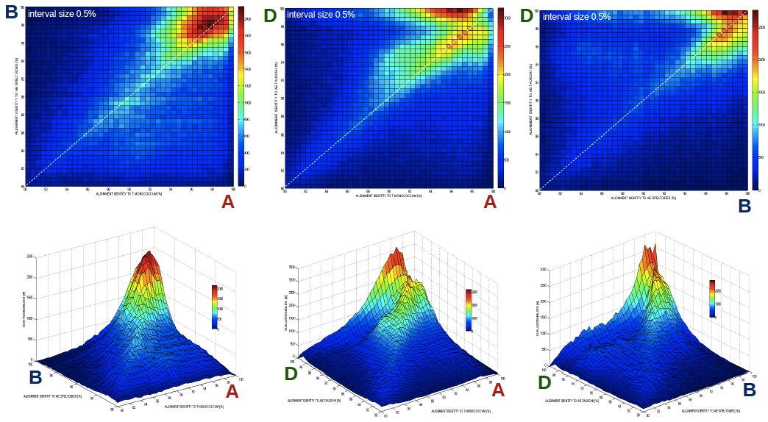
The Three Nephews: Similarity on a Sequence Basis
Notes:
Fairly complicated due to close similarity among subgenomes;

Slide 20
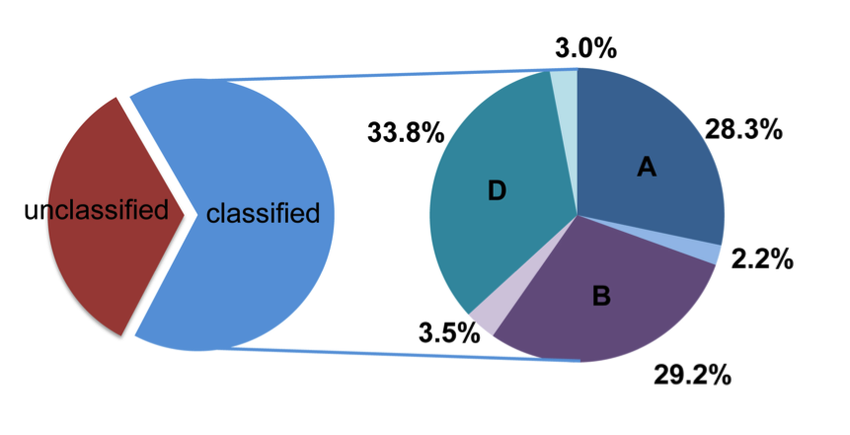
Wheat A, B and D Assignment using Machine Learning (SVM)

Slide 21
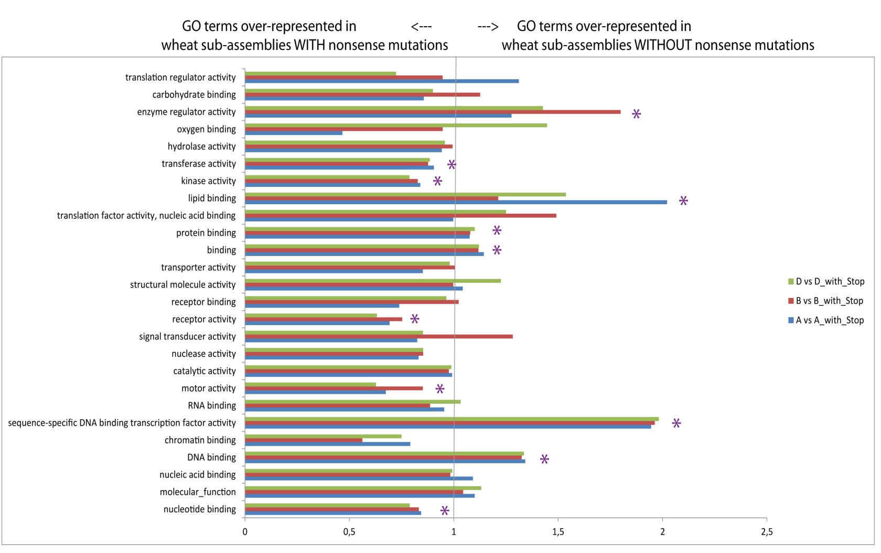
Particular Gene Categories are preferentially retained

Slide 22
Summary
Almost full gene complement detected and structured
10000s of pseudogenes detected
Separation of A, B and D using machine learning with > 75% accuracy
Complementary to chromosome sorting approaches
Applicable to polyploids in general to get genome overview
Rapid and economic approach to pragmatically cope with limitations in sequence technology
Franz Marc
„Hocken im Schnee“

Slide 23
„In Silico Exon Capture“ Statistics

Slide 26
The composition of A, B and D are similar

Slide 27






acknowledgements
The UK Wheat Consortium
Mike Bevan
Neil Hall
Anthony Hall
Keith Edwards
Rachel Brenchley
CSHL
Dick McCombie
UC Davis & USDA Albany
Jan Dvorak
Mincheng Luo
Olin Anderson
Kansas State University
Bikram Gill
Sunish Segal
MIPS
Matthias Pfeifer
Klaus Mayer
All other group members
EBI
Paul Kersey
Dan Bolser

